Slide 1

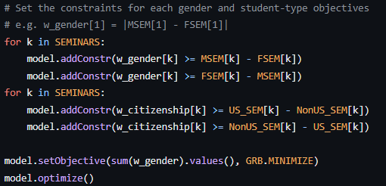
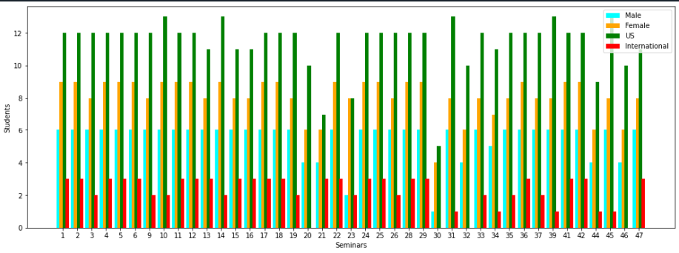
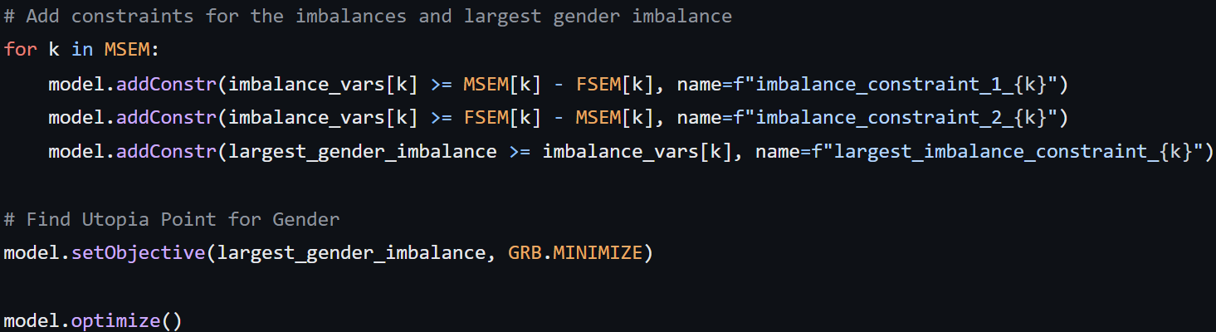
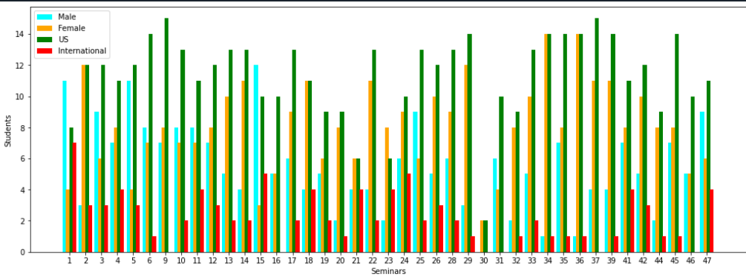
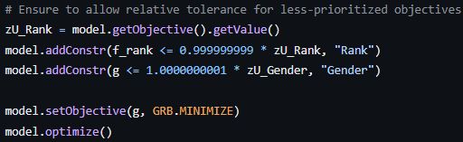
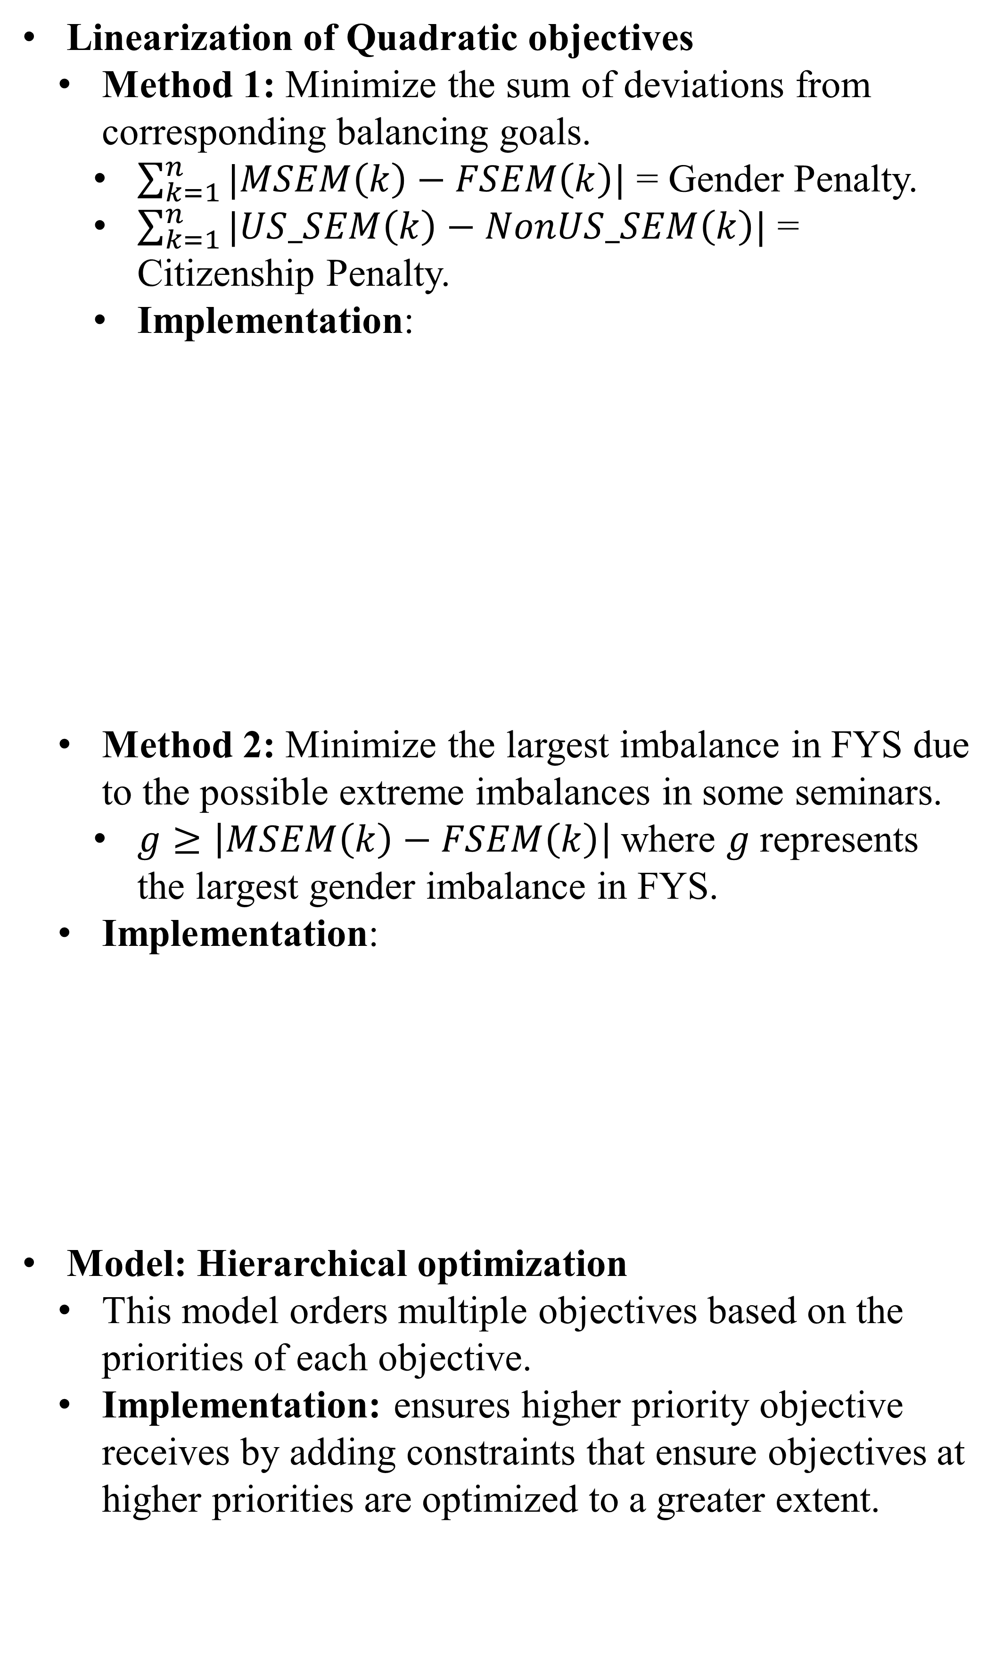
Enhancing Diversity and Seminar Placement in Dickinson’s First Year Seminar Assignment Program with Computational Optimization Techniques
John Chu
Supervised by: Professor Dick Forrester
Department of Mathematics and Computer Science, Dickinson College
ABSTRACT
METHODS
RESULT
Background: Dickinson’s First-Year Seminar assignment (FYS) program balances gender and student-type ratios in the classroom and satisfies students’ ranked choices of seminars.
Research Question: Explore multiple approaches to improve diversity and assignment of ranked seminar choices in the existing FYS assignment program.
Tool & Software: Python Gurobi Solver
Model: Multi-objective optimization (students’ ranked choices (rank), gender, and student type)
Main Goal: Choose the approach that corresponds the most to Dickinson’s mission for practical use of assigning future incoming first-year students.
Linearization of Quadratic objectives
Method 1: Minimize the sum of deviations from corresponding balancing goals.
$\sum_{k=1}^{n}{|MSEM\left(k\right)−FSEM\left(k\right)|}$ = Gender Penalty.
$\sum_{k=1}^{n}{|US_SEM\left(k\right)−NonUS_SEM\left(k\right)|}$ = Citizenship Penalty.
Implementation:
Method 2: Minimize the largest imbalance in FYS due to the possible extreme imbalances in some seminars.
$g≥\left|MSEM\left(k\right)−FSEM\left(k\right)\right|$where $g$represents the largest gender imbalance in FYS.
Implementation:
Model: Hierarchical optimization
This model orders multiple objectives based on the priorities of each objective.
Implementation: ensures higher priority objective receives by adding constraints that ensure objectives at higher priorities are optimized to a greater extent.
Existing Dickinson FYS Assignment Program
Program run-time: Approximately 10 minutes
Assignment results:
First-choice: 48.028673835125446%
Second-choice: 27.956989247311824%
Variance: 0.661% (gender); 0.75% (student type)
Hierarchical Implementation
Program runtime: Approximately 1 second
Method 1: Minimize the sum of deviations from corresponding balance goals
Assignment results:
First-choice: 56.272401433691755%
Second-choice: 28.673835125448026%
Variance: 1.68% (gender); 38.1% (student type)
Method 2: Minimize the largest imbalance in FYS
Assignment results:
First-choice: 56.272401433691755%
Second-choice: 28.673835125448026%
Variance: 0.94% (gender); 38.1% (student type)
CONCLUSION
Linearized quadratic objectives for gender and student type using two linearization methods.
Used a hierarchical multi-objective model to implement improved features.
Accomplished a 600% reduction in program runtime.
We can always alter the priorities of objectives depending on Dickinson’s mission values toward assignment outcome.
REFERENCE
Forrester, R, & Hutson, K. (2014). Balancing faculty and student preferences in the assignment of students to groups. Decision Sci. J. Innov. Educ, 11 Apr.
Forrester, R., Hutson, K., & To, T. (2013). Improving the quality of the assignment of students to first-year seminars. OR Insight, 26(2), 120– 139.
To. (2011, May 17). Mathematical Techniques for Assigning First Year Seminars.

